Slide 1
CSE450
Data Mining
Week 3:
  Introduction to classification
  Linear classifier

Slide 2
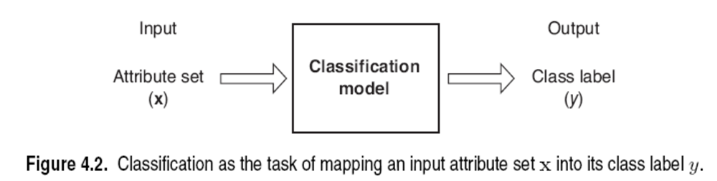
Classification: Definition
Given a collection of records (training set )
  Each record contains a set of attributes, one of the attributes is the class.
Find a model for class attribute as a function of the values of other attributes.
Goal: previously unseen records should be assigned a class as accurately as possible.
  A test set is used to determine the accuracy of the model. Usually, the given data set is divided into training and test sets, with training set used to build the model and test set used to validate it.
CSEDIU

Slide 3

Illustrating Classification Task
CSEDIU

Slide 4




Examples of Classification Task
Predicting tumor cells as benign or malignant
Classifying credit card transactions
as legitimate or fraudulent
Classifying secondary structures of protein
as alpha-helix, beta-sheet, or random
coil
Categorizing news stories as finance,
weather, entertainment, sports, etc
CSEDIU

Slide 5
Classification Techniques
Decision Tree based Methods
Rule-based Methods
Memory based reasoning
Neural Networks
Naïve Bayes and Bayesian Belief Networks
Support Vector Machines
We will start with a simple linear classifier
CSEDIU

Slide 6
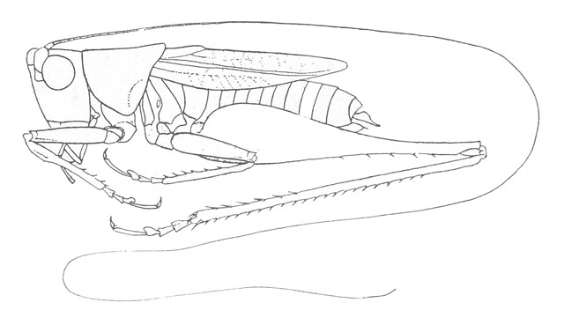
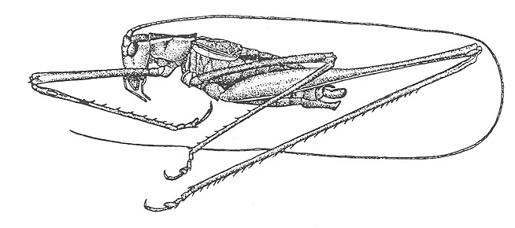
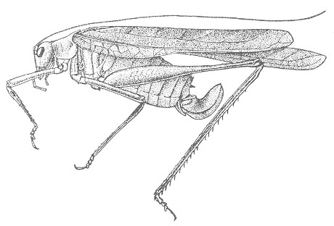
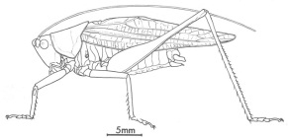
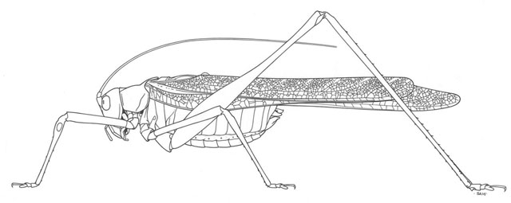
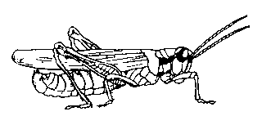
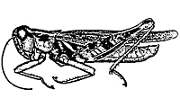
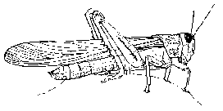
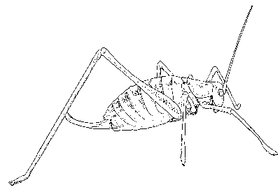
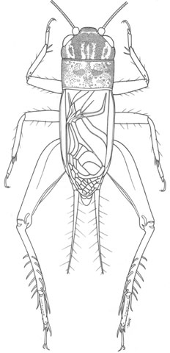
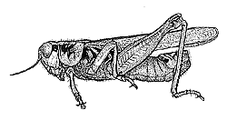
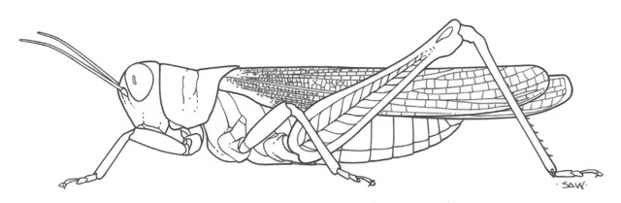
The Classification Problem
(informal definition)
Katydids
Given a collection of annotated data. In this case 5 instances Katydids of and five of Grasshoppers, decide what type of insect the unlabeled example is.
Grasshoppers
Katydid or Grasshopper?
CSEDIU

Slide 7
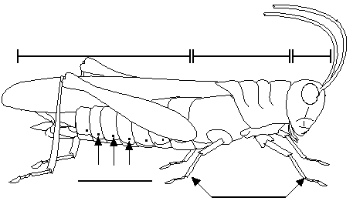
For any domain of interest,
we can measure features
Color {Green, Brown, Gray, Other}
Has Wings?
Abdomen
Length
Thorax Length
Antennae
Length
Mandible
Size
Spiracle
Diameter
Leg Length
CSEDIU

Slide 8
We can store features in a database.
My_Collection
Insect ID | Abdomen Length | Antennae Length | Insect Class
1 | 2.7 | 5.5 | Grasshopper
2 | 8.0 | 9.1 | Katydid
3 | 0.9 | 4.7 | Grasshopper
4 | 1.1 | 3.1 | Grasshopper
5 | 5.4 | 8.5 | Katydid
6 | 2.9 | 1.9 | Grasshopper
7 | 6.1 | 6.6 | Katydid
8 | 0.5 | 1.0 | Grasshopper
9 | 8.3 | 6.6 | Katydid
10 | 8.1 | 4.7 | Katydids
The classification problem can now be expressed as:
Given a training database (My_Collection), predict the class label of a previously unseen instance
previously unseen instance =
11 | 5.1 | 7.0 | ???????
CSEDIU

Slide 9

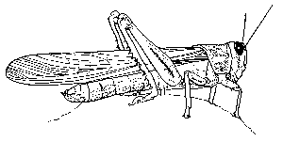

Grasshoppers
Katydids
10
9
8
7
6
Antenna Length
5
4
3
2
1
1
2
3
4
5
6
7
8
9
10
Abdomen Length
CSEDIU

Slide 10
Grasshoppers
Katydids
10
9
8
7
6
Antenna Length
5
Each of these data objects are called…
exemplars
(training) examples
instances
tuples
4
3
2
1
1
2
3
4
5
6
7
8
9
10
Abdomen Length
CSEDIU

Slide 11

We will return to the previous slide in two minutes. In the meantime, we are going to play a quick game.
CSEDIU

Slide 12
Problem 1
Examples of class A
Examples of class B
3 4
5 2.5
1.5 5
5 2
6 8
8 3
2.5 5
4.5 3
CSEDIU

Slide 13


Problem 1
What class is this object?
Examples of class A
Examples of class B
3 4
5 2.5
8 1.5
What about this one, A or B?
1.5 5
5 2
6 8
8 3
4.5 7
2.5 5
4.5 3
CSEDIU

Slide 14

Problem 2
Oh! This ones hard!
Examples of class A
Examples of class B
4 4
5 2.5
8 1.5
5 5
2 5
6 6
5 3
3 3
2.5 3
CSEDIU

Slide 15

Problem 3
Examples of class A
Examples of class B
6 6
4 4
5 6
This one is really hard!
What is this, A or B?
1 5
7 5
6 3
4 8
3 7
7 7
CSEDIU

Slide 16


Why did we spend so much time with this game?
Because we wanted to show that almost all classification problems have a geometric interpretation, check out the next 3 slides…
CSEDIU

Slide 17

Problem 1
10
9
8
Examples of class A
Examples of class B
7
6
Left Bar
5
4
3
2
3 4
5 2.5
1
1
2
3
4
5
6
7
8
9
10
Right Bar
1.5 5
5 2
Here is the rule again.
If the left bar is smaller than the right bar, it is an A, otherwise it is a B.
6 8
8 3
2.5 5
4.5 3
CSEDIU

Slide 18

Problem 2
10
9
8
Examples of class A
Examples of class B
7
6
Left Bar
5
4
3
2
4 4
5 2.5
1
1
2
3
4
5
6
7
8
9
10
Right Bar
5 5
2 5
Let me look it up… here it is.. the rule is, if the two bars are equal sizes, it is an A. Otherwise it is a B.
6 6
5 3
3 3
2.5 3
CSEDIU

Slide 19

Problem 3
100
90
80
Examples of class A
Examples of class B
70
60
Left Bar
50
40
30
20
4 4
5 6
10
10
20
30
40
50
60
70
80
90
100
Right Bar
1 5
7 5
6 3
4 8
The rule again:
if the square of the sum of the two bars is less than or equal to 100, it is an A. Otherwise it is a B.
3 7
7 7
CSEDIU

Slide 20
Grasshoppers
Katydids
10
9
8
7
6
Antenna Length
5
4
3
2
1
1
2
3
4
5
6
7
8
9
10
Abdomen Length
CSEDIU

Slide 21
previously unseen instance =
11 | 5.1 | 7.0 | ???????
We can “project” the previously unseen instance into the same space as the database.
We have now abstracted away the details of our particular problem. It will be much easier to talk about points in space.
10
9
8
7
6
Antenna Length
5
4
3
2
1
Katydids
Grasshoppers
1
2
3
4
5
6
7
8
9
10
Abdomen Length
CSEDIU

Slide 22
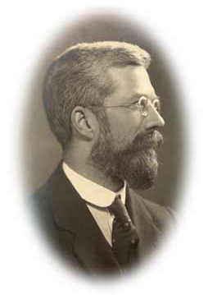
Simple Linear Classifier
10
9
8
7
R.A. Fisher
1890-1962
6
5
If previously unseen instance above the line
then
class is Katydid
else
class is Grasshopper
4
3
2
1
Katydids
Grasshoppers
1
2
3
4
5
6
7
8
9
10
CSEDIU

Slide 23
Classification Accuracy
 |  | Predicted class
 |  | Class = Katydid (1) | Class = Grasshopper (0)
Actual Class | Class = Katydid (1) | f₁₁ | f₁₀
 | Class = Grasshopper (0) | f₀₁ | f₀₀
Number of correct predictions f₁₁ + f₀₀
Accuracy = --------------------------------------------- = -----------------------
Total number of predictions f₁₁ + f₁₀ + f₀₁ + f₀₀
Number of wrong predictions f₁₀ + f₀₁
Error rate = --------------------------------------------- = -----------------------
Total number of predictions f₁₁ + f₁₀ + f₀₁ + f₀₀
CSEDIU

Slide 24
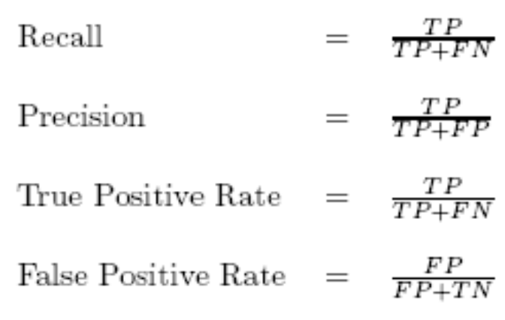
Confusion Matrix
In a binary decision problem, a classifier labels examples as either positive or negative.
Classifiers produce confusion/ contingency matrix, which shows four entities: TP (true positive), TN (true negative), FP (false positive), FN (false negative)
Confusion Matrix
 | Positive (+) | Negative (-)
Predicted positive (Y) | TP | FP
Predicted negative (N) | FN | TN
CSEDIU

Slide 25


The simple linear classifier is defined for higher dimensional spaces…
CSEDIU

Slide 26
… we can visualize it as being an n-dimensional hyperplane
CSEDIU

Slide 27
It is interesting to think about what would happen in this example if we did not have the 3rd dimension…
CSEDIU

Slide 28
We can no longer get perfect accuracy with the simple linear classifier…
We could try to solve this problem by user a simple quadratic classifier or a simple cubic classifier..
However, as we will later see, this is probably a bad idea…
CSEDIU

Slide 29
Which of the “Problems” can be solved by the Simple Linear Classifier?
10
9
8
7
6
Perfect
Useless
Pretty Good
5
4
3
2
1
1
2
3
4
5
6
7
8
9
10
100
10
90
9
Problems that can be solved by a linear classifier are call linearly separable.
80
8
70
7
60
6
50
5
40
4
30
3
20
2
10
1
10
20
30
40
50
60
70
80
90
100
1
2
3
4
5
6
7
8
9
10
CSEDIU

Slide 30
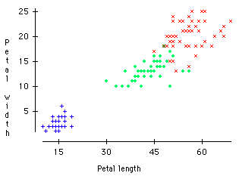
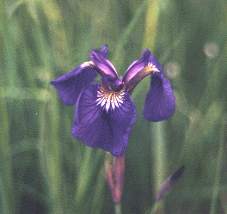

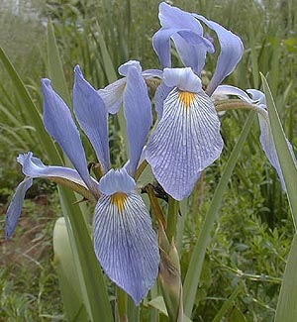
Virginica
A Famous Problem
R. A. Fisher’s Iris Dataset.
3 classes
50 of each class
The task is to classify Iris plants into one of 3 varieties using the Petal Length and Petal Width.
Setosa
Versicolor
Iris Setosa
CSEDIU
Iris Versicolor
Iris Virginica

Slide 31
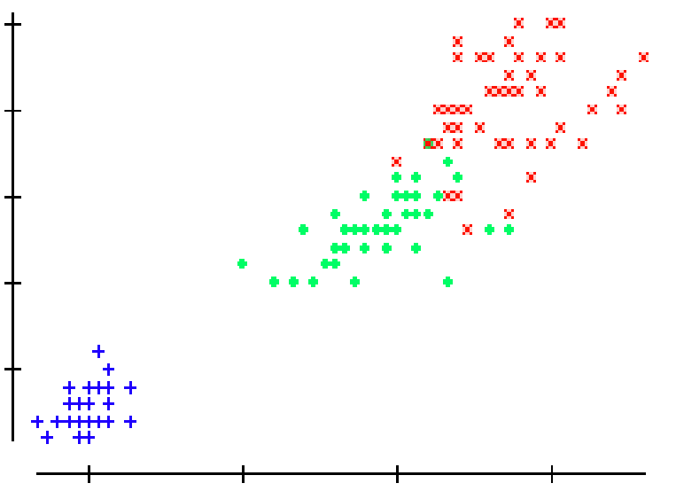
We can generalize the piecewise linear classifier to N classes, by fitting N-1 lines. In this case we first learned the line to (perfectly) discriminate between Setosa and Virginica/Versicolor, then we learned to approximately discriminate between Virginica and Versicolor.
Virginica
Setosa
Versicolor
If petal width > 3.272 – (0.325 * petal length) then class = Virginica
Elseif petal width…
CSEDIU

Slide 32
We have now seen one classification algorithm, and we are about to see more. How should we compare them?
Predictive accuracy
Speed and scalability
  time to construct the model
  time to use the model
  efficiency in disk-resident databases
Robustness
  handling noise, missing values and irrelevant features, streaming data
Interpretability:
  understanding and insight provided by the model
CSEDIU

